Slide 1
Modernize your SIEM in the cloud with Azure Sentinel
Cristhofer Romeo Muñoz
Program Manager II, C+AI Division
Notes:
In today’s landscape, it is more important than ever that higher education institutions reimagine the campus experience. Technology has a critical role in driving this transformation. Microsoft can help drive innovative student engagement, transform operations, and ensure a secure, connected campus to empower you to reimagine education.

Slide 2
76% report increasing security data*
IT deployment &
maintenance
Sophistication of threats
Smart cities
Vehicles
Sensors
Energy systems
Marketplaces
Expanding digital estate
Equipment
t
Partners
44% of alerts are
never investigated
Security Operations Challenges
Citizens
Customers
Supply chains
Too many disconnected
products
On-premises
Manufacturers
Mobile devices
3.5M unfilled security
jobs in 2021
Lack of automation
Notes:
Today, organizations are faced with the incredibly difficult task of trying to protect their expanded digital estate from increasing cyber threats. The move to the cloud and a mobile workforce have pushed the border of your estate beyond the boundary of your physical network. Your data and users and systems are everywhere.
Meanwhile the frequency and sophistication of attacks are ever growing. Regardless of the size of your organization or the industry, you are a target.​
This is the challenge that we all struggle with in IT security. And it's a challenge we at Microsoft think that we can uniquely help with.

Slide 3
IT deployment &
maintenance
Sophistication of threats
76% report increasing security data*
44% of alerts are
never investigated
Security operations challenges
Too many disconnected
products
3.5M unfilled security
jobs in 2021
Lack of automation
*ESG: Security Analytics and Operations: Industry Trends in the Era of Cloud Computing 2019
Notes:
The SecOps mission of protecting organizations’ information and assets is becoming increasingly difficult. Attack techniques, frequency, and complexity are evolving fast. Security teams are under strain from the expanding breadth of defensive technologies, accelerating hybrid cloud adoption, and borderless, zero-trust networks. The shortage of SecOps talent makes this problem worse.
Considering the future needs of SOCs, these are the most prominent pain points:
Threats continue to grow in complexity and volume
Attacks are increasingly heterogeneous. A typical attack spans different parts of the enterprise and crosses various resource types: it might start from an IoT device, proceed to an endpoint, spread to a cloud service or to a database, involve multiple user accounts or tenants, and so on.
Alert fatigue: SOCs see too many alerts from disconnected products
Enterprise SOCs typically have dozens of security products, each producing a large volume of alerts. In isolation, these products often have high false positive rates and poor response prioritization, resulting in deafening alert noise. Attacks fall through the cracks despite generating alerts. Unfortunately, legacy SIEMs are functioning only as aggregators and don’t increase response capabilities. Enterprise SOCs need a way to integrate their security products to reduce the noise, prioritize alerts, and enable investigation and hunting across the entire dataset.
There is a global shortage of security analysts and experience
The need for skilled security professionals has greatly increased, and supply cannot meet current or future demand. A recent report by CSO magazine showed that this global talent shortage will increase to 3.5 million unfilled security jobs by 2021.
Investigation is complex and time-consuming
Every second counts when SecOps personnel are handling a threat that might jeopardize their organization. The clock is ticking fast, but investigation requires highly skilled security analysts and can often take days or weeks.
Current solutions are not architected for today’s demands, or tomorrow’s
Legacy on-premises SIEMs require powerful hardware and extensive maintenance that make them expensive to operate. Storage and compute needs increase dramatically during an incident, which is difficult for an on-prem footprint to accommodate. The move to the cloud has enabled a new degree of enterprise scale-out, and with the explosion of cloud-born data, legacy SIEMs are less and less able to cope with the demand.

Slide 4
Introducing Azure Sentinel INTELLIGENT, CLOUD-NATIVE SIEM
Delivers instant value to your defenders
Notes:
That’s why we re-imagined the SIEM tool to introduce a new cloud-native solution called Microsoft Azure Sentinel - providing intelligent security analytics at cloud scale for your entire enterprise.
Azure Sentinel makes it easy to collect security data across your entire hybrid organization from devices, users, apps, servers and any cloud, it uses the power of artificial intelligence to ensure you are identifying real threats quickly, and unleashes you from the burden of traditional SIEMs by eliminating the need to spend time on setting up, maintaining and scaling infrastructure.
Since it is built on Azure, it offers limitless cloud scale and speed, scaling automatically to address your needs.
Traditional SIEMs have also proven to be expensive to own and operate, often requiring you to commit upfront and incur high cost for infrastructure maintenance and data ingestion. With Azure Sentinel there will be no upfront costs, you will only pay for what you use, and we are offering free Office 365 activity data import to help you reduce security costs significantly
Meets your defenders where they are and delivers instant value
Choose from hundreds of built-in dashboards, hunting queries, analytics, playbooks and more
Guided hunting and investigation experiences help security analysts of all skill levels get their work done
Of course, Azure Sentinel offers all the extensibility you need to customize and create your own dashboards, analytics, workbooks
And even offers integration with professional-grade tools like Jupyter notebooks

Slide 5
Introducing Azure Sentinel INTELLIGENT, CLOUD-NATIVE SIEM
Delivers instant value to your defenders
Scales to support your growing digital estate
Notes:
Enables you to collect, store and analyze all of your security data with cloud scale and economics
Scale automatically as data volume and compute needs grows – incremental growth or bust during an incident
No infrastructure costs or upfront commitment - only pay for what you use
No infrastructure setup or maintenance
Agility to add data as you need it

Slide 6
Introducing Azure Sentinel INTELLIGENT, CLOUD-NATIVE SIEM
Delivers instant value to your defenders
Scales to support your growing digital estate
Uses AI and automation to improve effectiveness
Notes:
Leverages AI and automation as force multipliers for your SOC
Detect threats you may have otherwise missed
Fuse alerts into actionable, prioritized incidents – to reduce alert fatigue
Apply automation to reduce manual processes and speed response

Slide 7
End-to-end solution for security operations
Collect
Detect
Investigate
Respond
Visibility
Analytics
Hunting
Incidents
Automation
Powered by community + backed by Microsoft’s security experts
Notes:
Azure Sentinel delivers and end-to-end solution for security operations.
Starts with collecting all of your data and getting instant insight into that data via workbooks and queries.
Begin applying analytics to that data to find real threats from that sea of data.
Hunt through all your data using built-in exploratory queries – use bookmarks and live stream tools to track notable events and monitor new activities
Manage and investigate incidents using graphs and timeline views.
Automate investigation and remediation playbooks
All of this is powered by a community of security analysts – AND – backed by Microsoft security experts who leverage their vast experience defending Microsoft services to contribute analytics, queries, playbooks and more

Slide 8
10 steps to Modernize your SIEM

Slide 9
Visibility

Slide 10
Collect security data at cloud scale from any source
1
AZURE + MICROSOFT 365 Security Alerts, Activity Data
COLLECTORS
CEF, Syslog, Windows, Linux
AZURE SENTINEL
TAXII + MS Graph
Threat Indicators
APIs
Custom Logs
AZURE MONITOR LOG ANALYTICS
Notes:
Our goal is to make it easy for you to collect data across all sources in your organization. Azure Sentinel has built-in connectors that help you do just that-
One-click integration with Microsoft solutions
Data connectors for growing list of other technologies – on-premises and cross-cloud
Support for standard log formats (CEF/Syslog and WEF)
Specialized TAXII and Graph connectors for threat intelligence data
REST API for connecting to cloud solutions
Proven log analytics platform with more than 10Pb of daily data ingestion

Slide 11
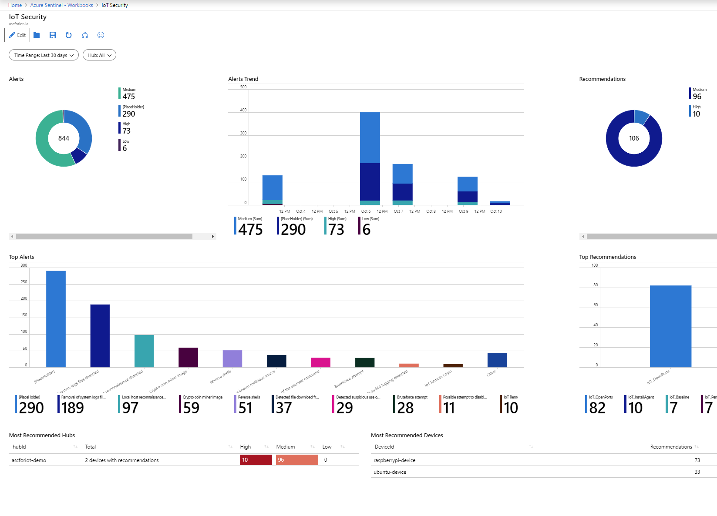
Use workbooks to power interactive dashboards
2
Choose from a gallery of workbooks
Customize or create your own workbooks using queries
Take advantage of rich visualization options
Gain insight into one or more data sources
Notes:
After you connected your data sources to Azure Sentinel, you get instant visualization and analysis of data so that you can know what's happening across all your connected data sources, it enables interactive dashboards customized to your needs. Azure Sentinel gives you workbooks that provide you with the full power of tools already available in Azure as well as tables and charts that are built in to provide you with analytics for your logs and queries. You can either use built-in workbooks or create a new workbook easily, from scratch or based on an existing workbook.
Interactive dashboards
Combines multiple kinds of visualizations – including graphs and maps
Provides deep insights into a single data source or combining multiple sources
Powered by KQL queries, making workbooks easy to build and customize

Slide 12
DEMO

Slide 13
QUESTION
What data can you ingest in Azure Sentinel at no cost?
Notes:
Pop Quiz

Slide 14
ANSWER
Azure Activity Logs, Office 365 Activity Logs, Alerts from Microsoft Threat Protection are available at no cost.

Slide 15
Analytics

Slide 16
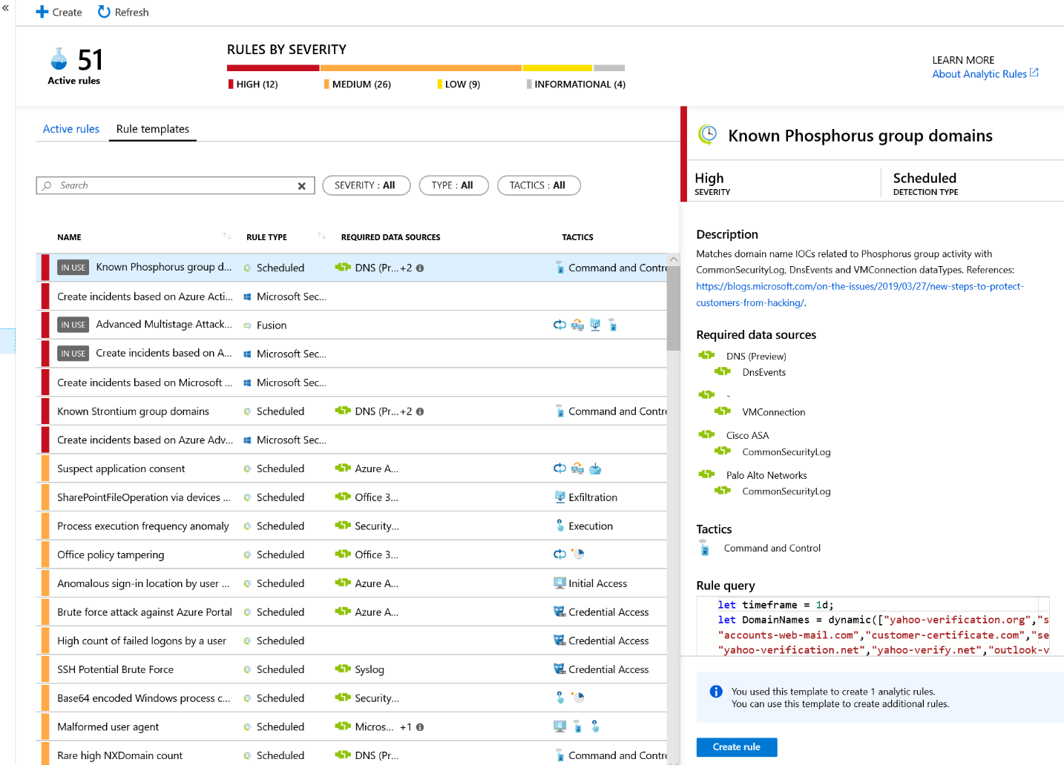
Leverage analytics to detect threats
3
Choose from more than 100 built-in analytics rules
Customize and create your own rules using KQL queries
Correlate events with your threat intelligence and now with Microsoft URL intelligence
Trigger automated playbooks
Notes:
After you connect data sources to Azure Sentinel, the next step is to identify suspicious activities and threats. Azure Sentinel provides built-in templates to enable you to do this and get notified of such threats. These templates were designed by Microsoft’s team of security experts and analysts based on known threats, common attack vectors, and suspicious activity escalation chains. After you enable these templates, they will automatically search for suspicious activity across your environment. Many of them can be customized to search for, or filter out, activities according to your needs.
More than 100 built-in alert rules were developed by Microsoft and community security experts
A wizard enables you to create your own analytics rules using KQL queries
Thresholds can be set to alert when activity levels exceed normal patterns
Correlation events with your threat intelligence and now with Microsoft intel about malicious URLs.
Microsoft has unparalleled view of evolving threat landscape
Customers can now match Microsoft URL TI with network logs
Matched MS indicators are added to the TI table for use like any other indicator
Retrospective lookbacks that match TI against historical event data and more TI types will be coming soon.
Alerts can be used to trigger automated playbooks

Slide 17
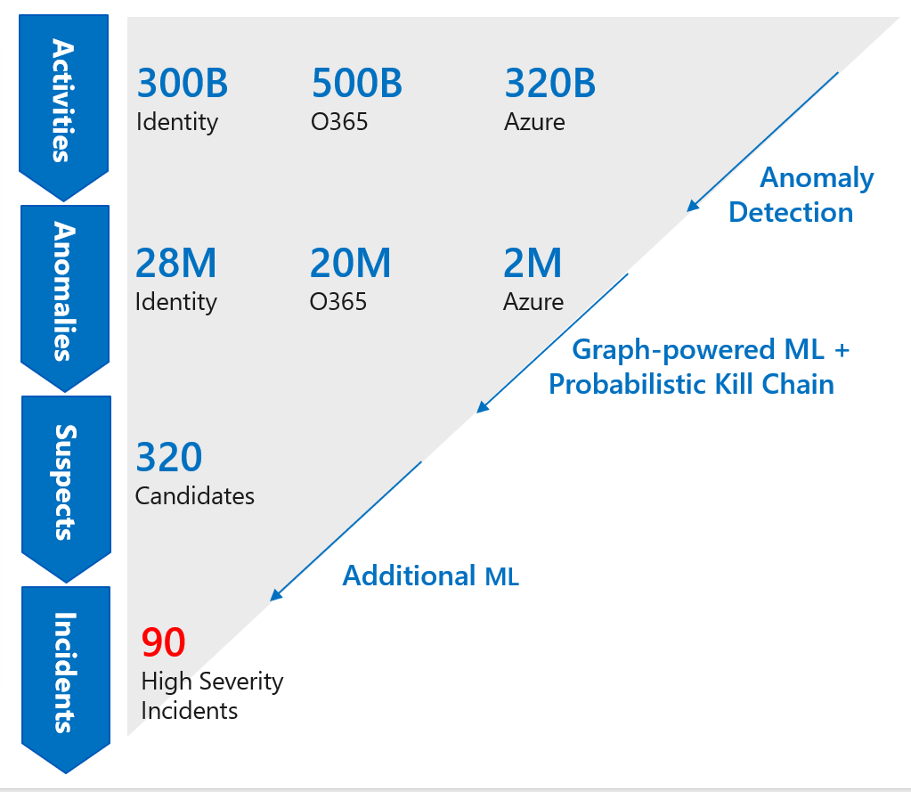
Tap into the power of ML increase your catch rate without increasing noise
3a
Use built–in models – no ML experience required
Detects anomalies using transferred learning
Fuses data sources to detect threats that span the kill chain
Simply connect your data and learning begins
Bring your own ML models (coming soon)
Notes:
Security analysts face a huge burden from triaging as they sift through a sea of alerts, and correlate alerts from different products manually or using a traditional correlation engine. That’s why Azure Sentinel uses state of the art, scalable machine learning algorithms to correlate millions of low fidelity anomalies to present a few high fidelity security incidents to the analyst.
Look at the example on this slide, Azure Sentinel using ML models that go from processing billions of signals and correlating the entire kill chain across many products to identify few high priority threats for you.
Built–in models offer the benefits of ML without the complexity
We apply proven off-the-shelf Machine Learning models for identifying suspicious logins across Microsoft identity services to discover malicious SSH accesses. By using transferred learning from existing Machine Learning models, Azure Sentinel can detect anomalies from a single dataset with accuracy.
In addition, we use a Machine Learning technique called fusion to connect data from multiple sources, like Azure AD anomalous logins and suspicious Office 365 activities, to detect 35 different threats that span different points on the kill chain.
Simply connect your data and learning begins

Slide 18
DEMO

Slide 19
Hunting

Slide 20
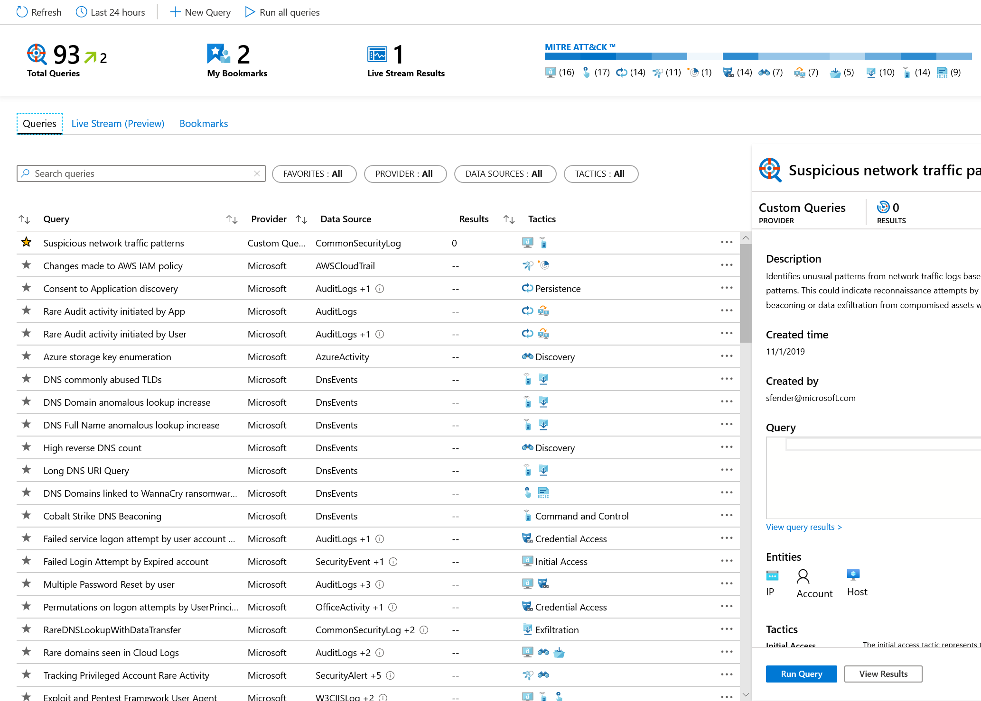
Start hunting over security data with fast, flexible queries
4
Run built-in threat hunting queries - no prior query experience required
Customize and create your own hunting queries using KQL
Integrate hunting and investigations
Notes:
Analysts need to proactively look for threats that may not have been discovered by security apps. Azure Sentinel includes built-in hunting queries that guide you to ask the right questions to find previously undiscovered threats.
With Azure Sentinel hunting, you can take advantage of the following capabilities:
• Built-in queries: A starting page provides preloaded query examples designed to get you started quickly and familiarize you with the tables and the query language. These built-in hunting queries are developed and fine-tuned by Microsoft security researchers and the GitHub community on a continuous basis to provide you with an entry point and help you start hunting for the beginnings of new attacks.
• Powerful query language with IntelliSense: Built on top of a query language, this gives you the flexibility you need to take hunting to the next level.
.• Use notebooks to automate investigation: Notebooks encapsulate all the hunting steps in a reusable playbook that can be shared with others in your organization.
• Query the stored data: The data is accessible in tables for you to query. For example, you can query process creation, DNS events, and many other event types.
• Links to community: Leverage the power of the greater community to find additional queries and data sources

Slide 21
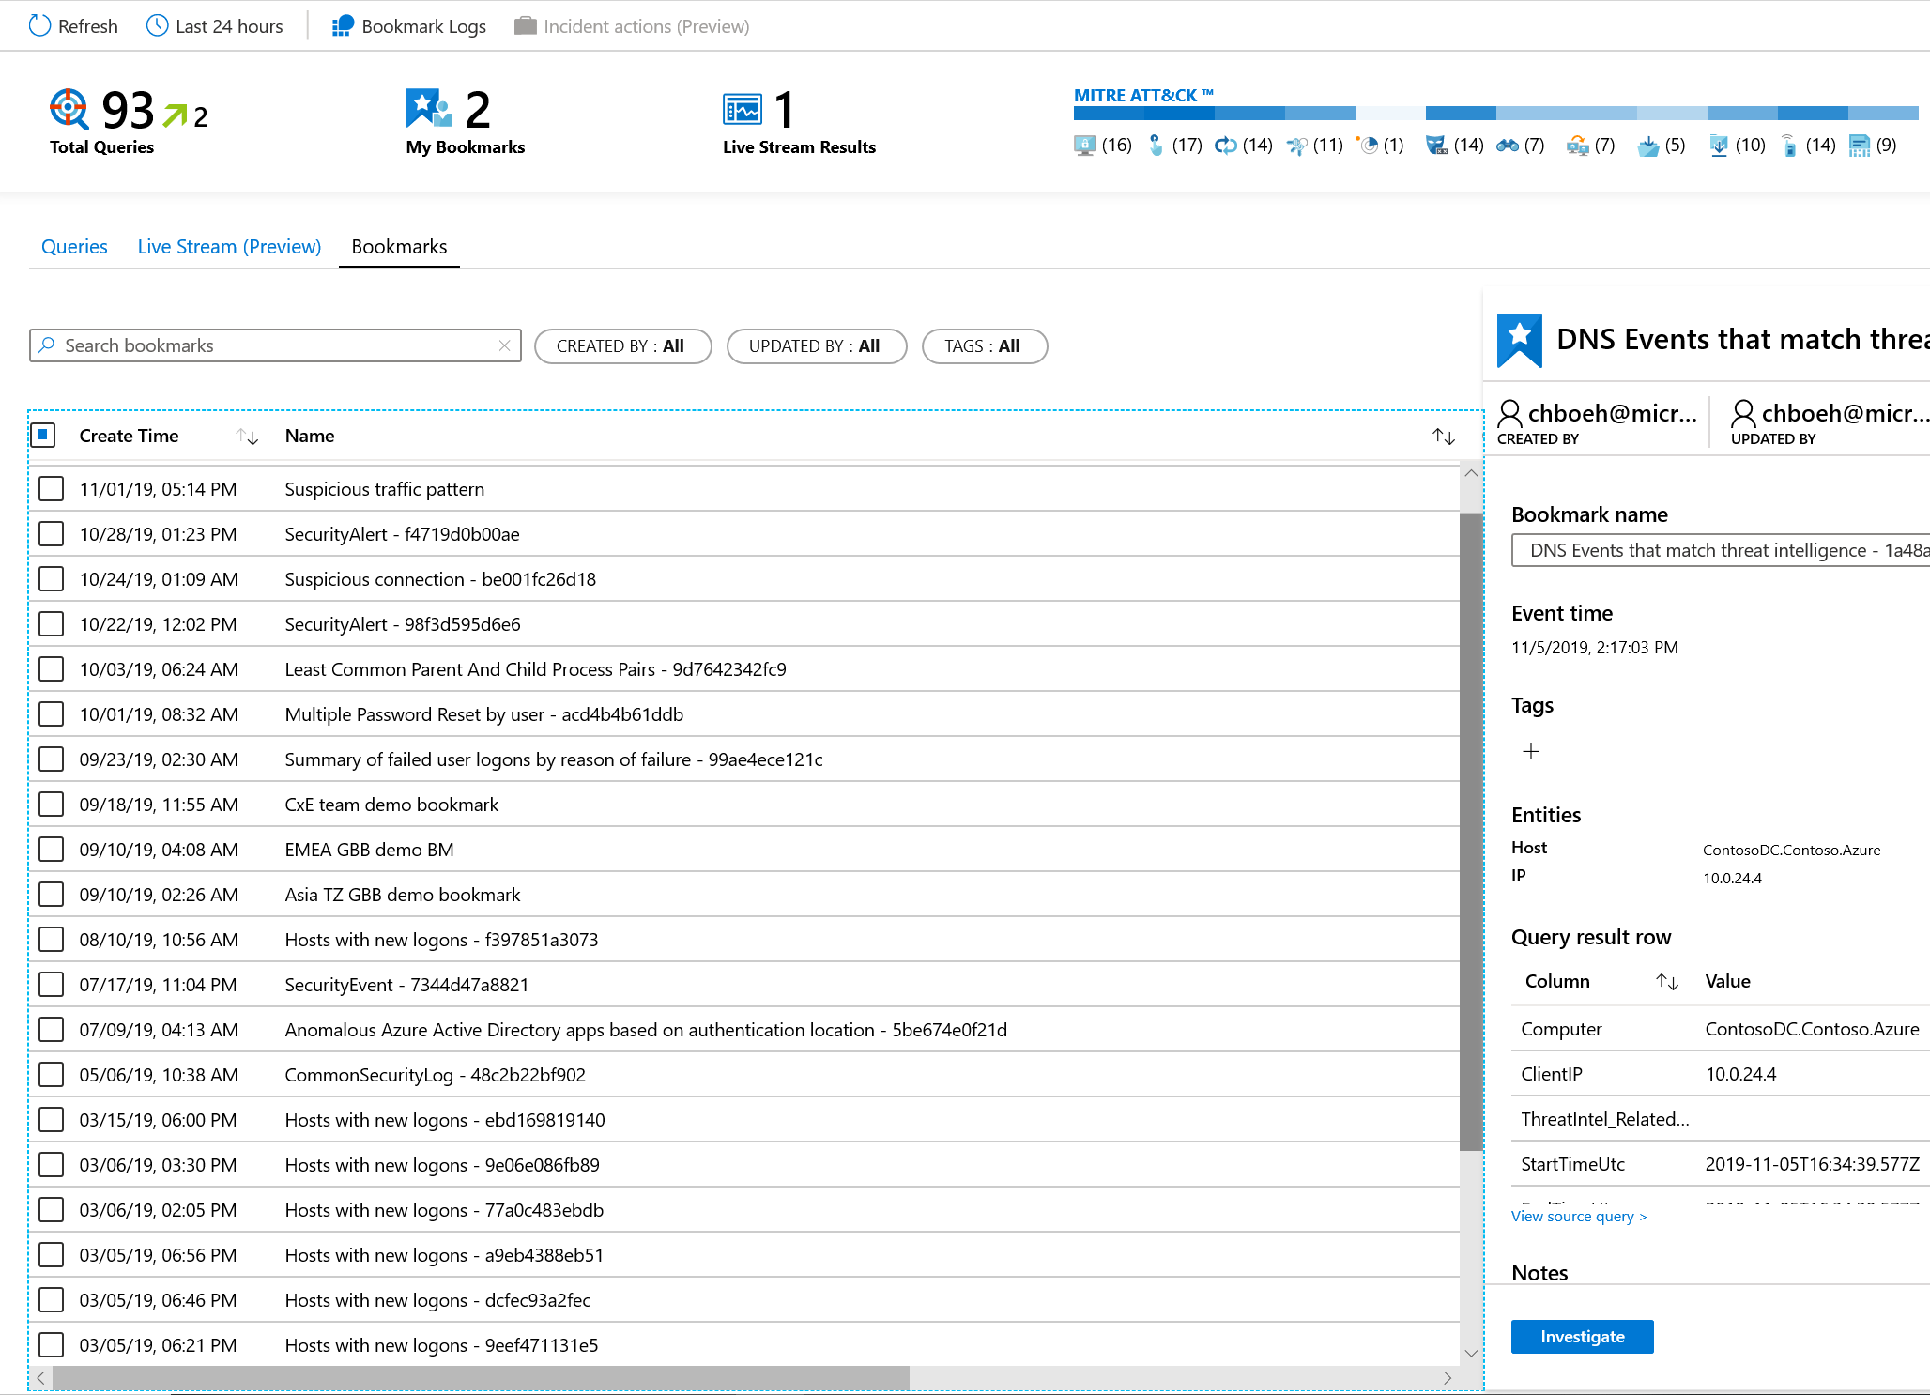
Use bookmarks and live stream to manage your hunts
5
Bookmark notable data
Start an investigation from a bookmark or add to an existing incident
Monitor a live stream of new threat related activity
Notes:
Create your own bookmarks: Bookmarks let you save items for later so you can use them to create an incident for investigation. You can bookmark a row, promote it to an incident, and then investigate with an investigation graph
Bookmarks enable you to flag notable data for further investigation
Annotate and visualize bookmarked data in an investigation graph
Add bookmarks to enrich existing incidents or create new ones
Receive notifications of new threat related activity using live stream

Slide 22
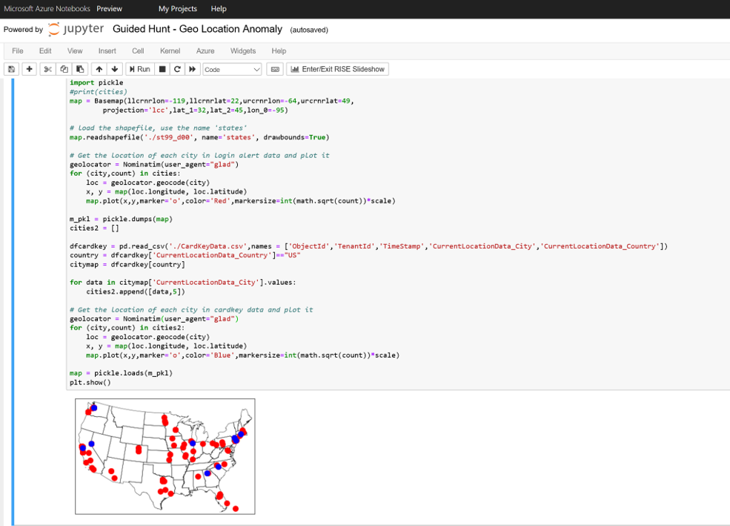
Use Jupyter notebooks for advanced hunting
5
Run in the Azure cloud
Save as sharable HTML/JSON
Query Azure Sentinel data
Bring external data sources
Use your language of choice - Python, SQL, KQL, R, …
Notes:
You can now launch Azure Notebooks directly from Azure Sentinel, making it easy to create and execute Jupyter notebooks to analyze your data. Notebooks combine live code, graphics, visualizations, and text, making them a valuable tool for threat hunters. Choose from a built-in gallery of notebooks developed by Microsoft security analysts or import others from GitHub to get started. These notebooks are the same professional-strength hunting solutions Microsoft’s own threat hunters use every day.
Hosted in the Azure cloud so accessible anytime from anywhere
Investigation workflow and data can be saved as sharable HTML/JSON document
Query Azure Sentinel data directly in the notebook
Bring external data sources such as threat Intelligence into your investigations
Supports Python, SQL, KQL, R, and other languages

Slide 23
DEMO

Slide 24
QUESTION
Where can you find and share hunting queries for
Azure Sentinel?

Slide 25
Hundreds of contributions, including data connectors, workbooks, analytics rules, queries, notebooks, parsers, functions, and playbooks are available on GitHub.
ANSWER

Slide 26
DEMO

Slide 27
Incidents

Slide 28
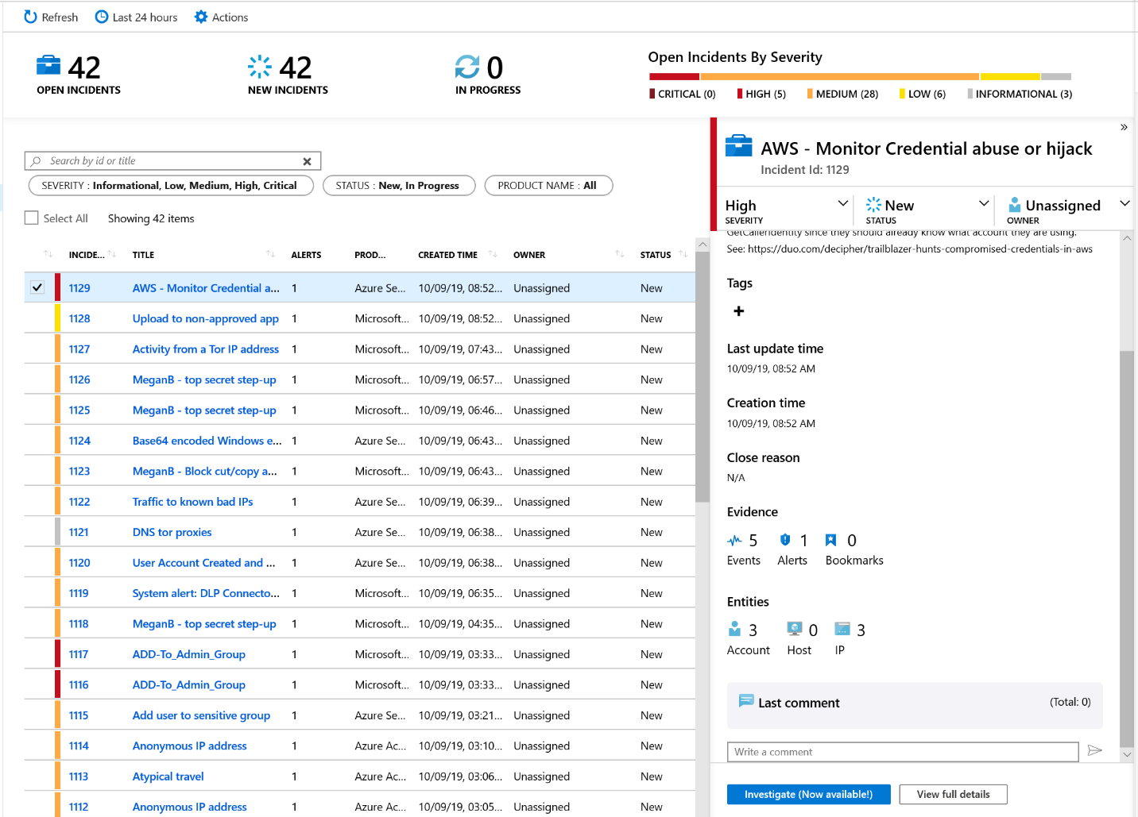
Start and track investigations from prioritized, actionable security incidents
7
Use incident to collect related alerts, events, and bookmarks
Manage assignments and track status
Add tags and comments
Trigger automated playbooks
Notes:
Azure Sentinel lets you create advanced alert rules, that generate incidents that you can assign and investigate. It gives you a prioritized list of alerts to formulate your incident response. An incident is created based on analytic rules that you created in the Analytics page. The properties related to the alerts, such as severity, and status, are set at the incident level. After you let Azure Sentinel know what kinds of threats you're looking for and how to find them, you can monitor detected threats by investigating incidents.
You can complete the following tasks quickly:
Monitor for alerts, events, and bookmarks related to a particular security threat, Automatically created from alerts or initiated by a security analyst when threat hunting
Assign to analysts for further investigation and status can be tracked
Analysts can easily tag incidents and add comments
Trigger automated playbooks from incidents

Slide 29
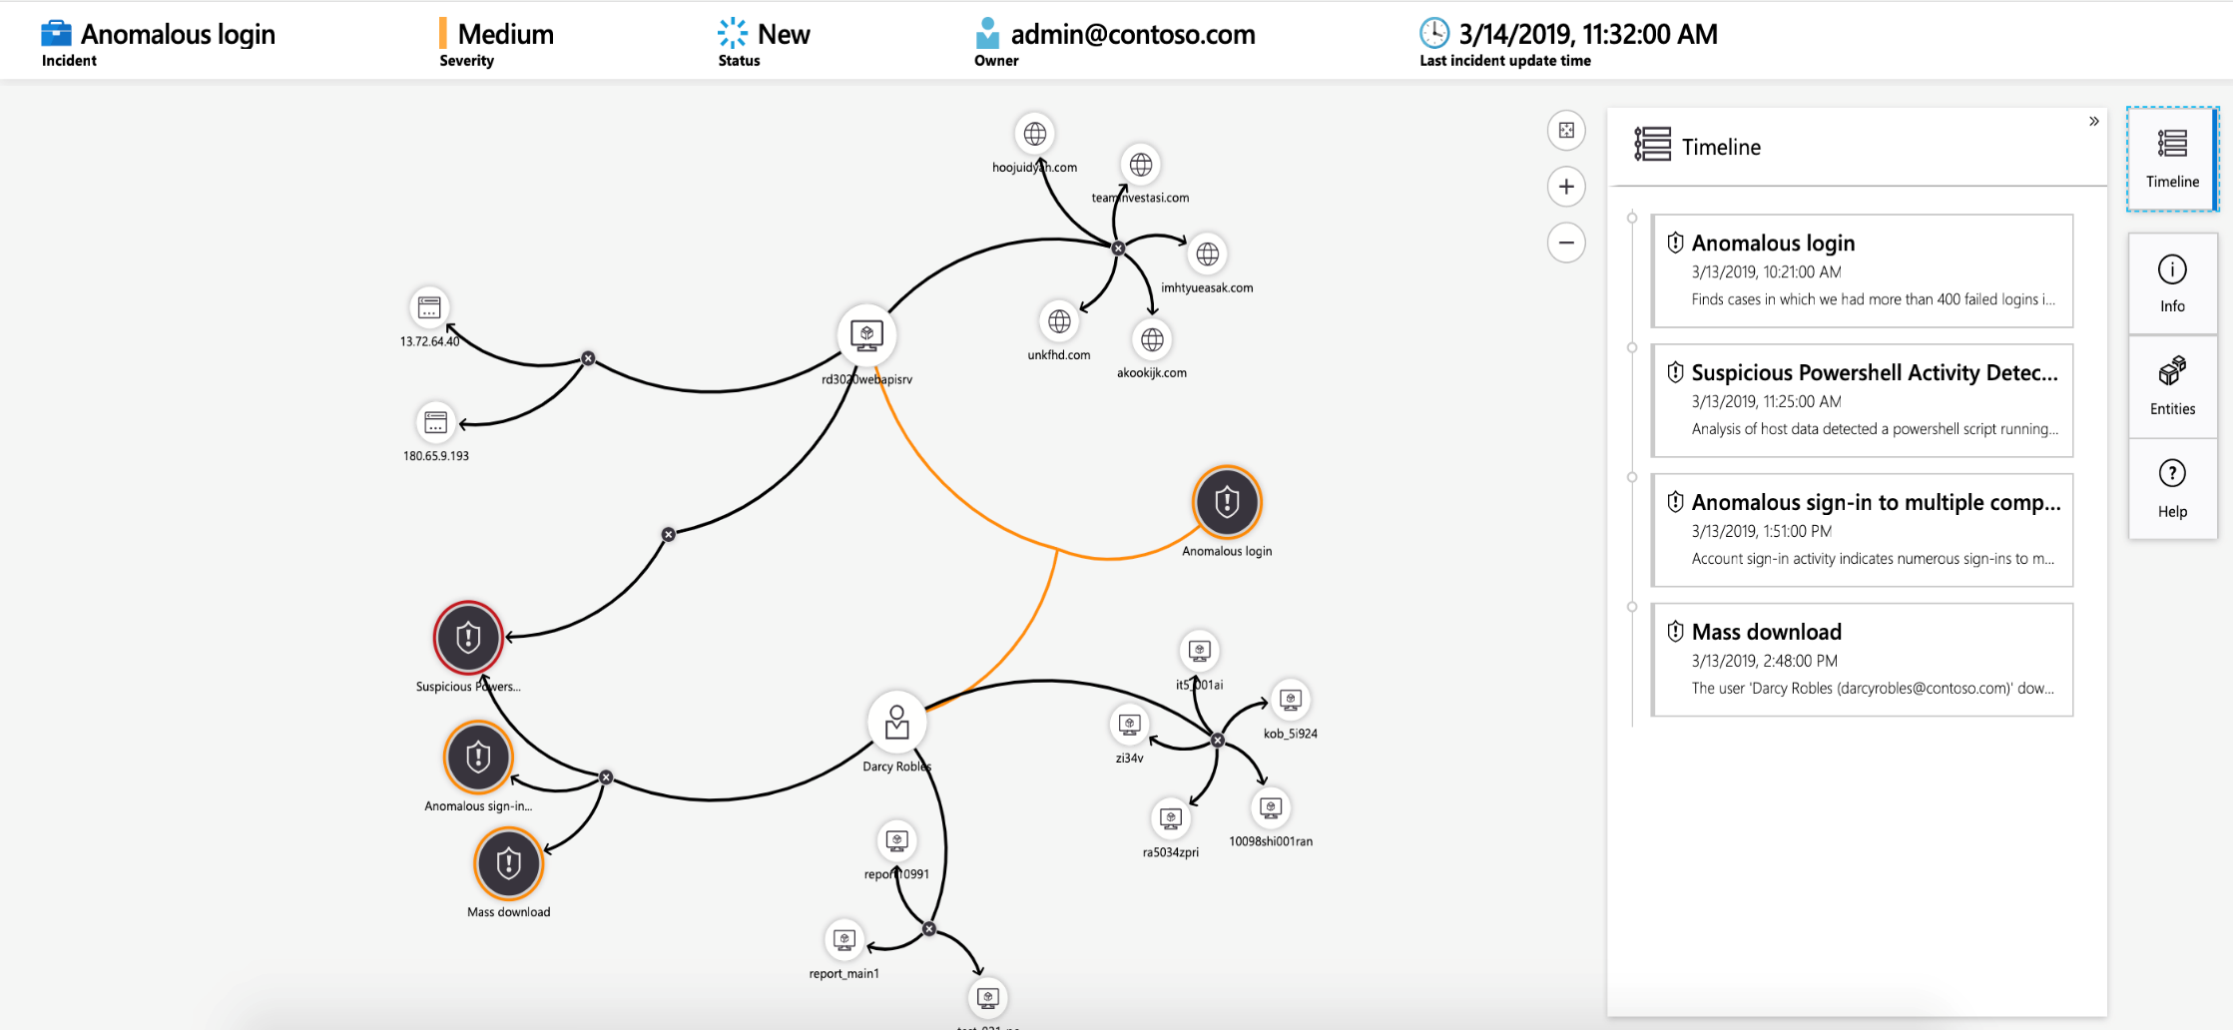
Visualize the entire attack to determine scope and impact
8
Navigate the relationships between related alerts, bookmarks, and entities
Expand the scope using exploration queries
View a timeline of related alerts, events, and bookmarks
Gain deep insights into related entities – users, domains, and more
Notes:
Graphical and AI-based investigation will reduce the time it takes to understand the full scope of an attack and its impact. The investigation graph enables analysts to ask the right questions for each investigation. The investigation graph helps you understand the scope, and identify the root cause, of a potential security threat by correlating relevant data with any involved entity. You can dive deeper and investigate any entity presented in the graph by selecting it and choosing between different expansion options.
The investigation graph provides you with:
Visual context from raw data: The live, visual graph displays entity relationships extracted automatically from the raw data. This enables you to easily see connections across different data sources.
Full investigation scope discovery: Expand your investigation scope using built-in exploration queries to surface the full scope of a breach.
Built-in investigation steps: Use predefined exploration options to make sure you are asking the right questions in the face of a threat.

Slide 30
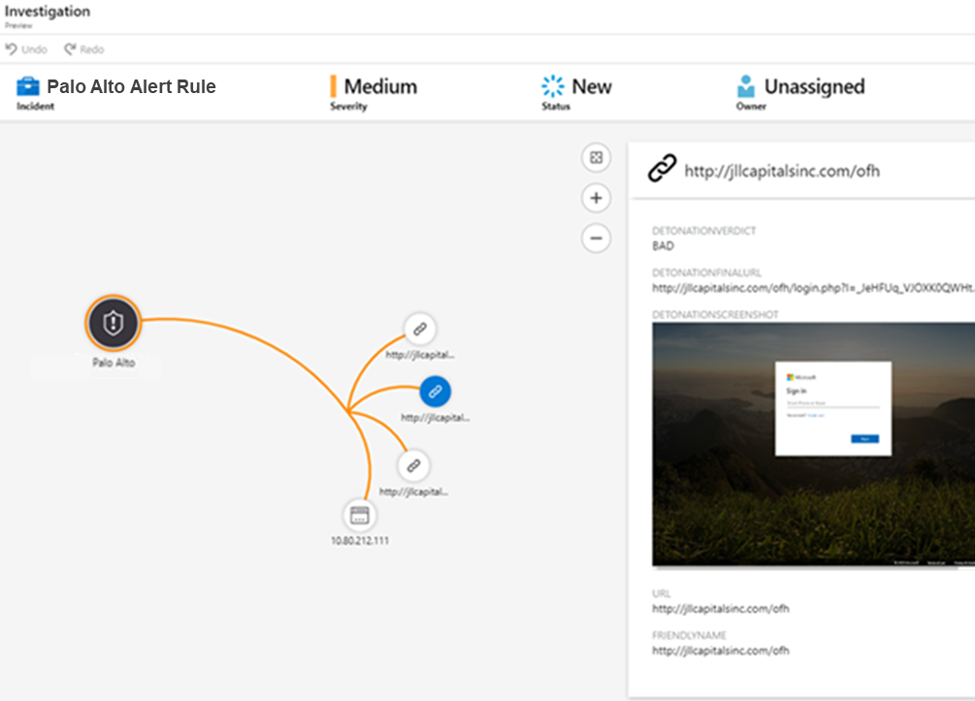
Gain deeper insight with built-in automated detonation
9
Configure URL Entities in analytics rules
Automatically trigger URL detonation
Enrich alerts with Verdicts, Final URLs and Screen Shots (e.g. for phishing sites)
Notes:
Azure Sentinel customers can now use the power of URL detonation to enrich alerts and quickly discover threats related to malicious URLs. When creating scheduled alerts, any URL data in the query results can be mapped to a new URL entity type. Whenever an alert containing a URL entity is generated, the mapped URL will be automatically detonated, and the investigation graph will be immediately enriched with the detonation results. A verdict, final URL and screen shot (especially useful for identifying phishing) can be used to quickly assess a potential threat. To use this feature, make sure you’ve enabled URL logging (e.g. threat logging) for your secure web gateways, web proxies, firewalls or legacy IDS/IPS. You can try this feature during the preview at no cost.
Azure Sentinel is introducing URL Entities
Use alert rules to automatically trigger URL detonation
Enrich alerts with Verdicts, Final URLs and Screen Shots (e.g. for phishing sites)

Slide 31
DEMO

Slide 32
QUESTION
“Defenders think in ________.
Attackers think in ________.”
John Lambert, Microsoft Threat Intelligence Center

Slide 33
ANSWER
“Defenders think in lists.
Attackers think in graphs.”
John Lambert, Microsoft Threat Intelligence Center

Slide 34
Automation

Slide 35
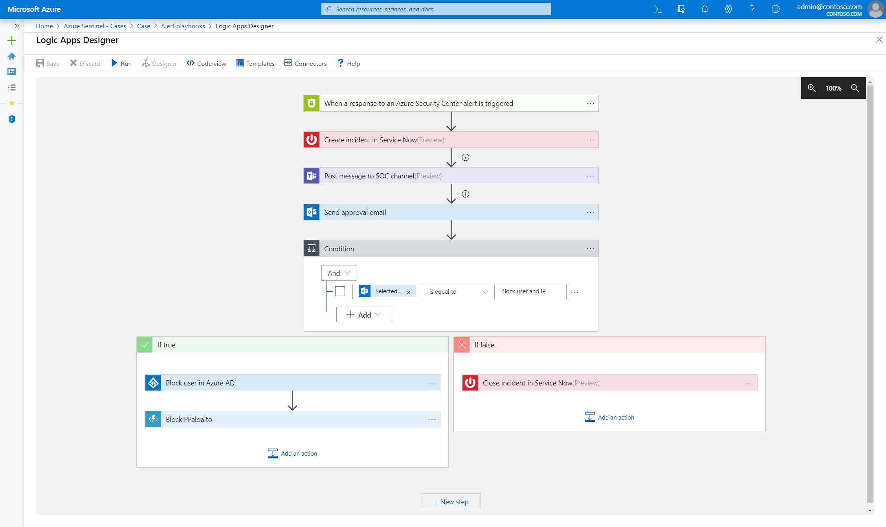
Automate and orchestrate security operations using integrated Azure Logic Apps
10
Build automated and scalable playbooks that integrate across tools
Choose from a library of samples
Create your own playbooks using 200+ built-in connectors
Trigger a playbook from an alert or incident investigation
Notes:
While AI sharpens your focus on finding problems, once you have solved the problem you don’t want to keep finding the same problems over and over – rather you want to automate response to these issues. Azure Sentinel provides built-in automation and orchestration with pre-defined or custom playbooks to solve repetitive tasks and to respond to threats quickly. Azure Sentinel will augment existing enterprise defense and investigation tools, including best-of-breed security products, homegrown tools, and other systems like HR management applications and workflow management systems like ServiceNow:
Powered by Azure Logic Apps and fully integrated with Azure Sentinel
Build automated and scalable playbooks that integrate across tools
Choose from a library of samples or create your own using more than 200+ built-in connectors plus generic connectors like HTTPS
Trigger a playbook from an alert or incident investigation

Slide 36
Example playbooks
Incident Management
Enrichment + Investigation
Remediation
Assign an Incident to an Analyst
Open a Ticket (ServiceNow/Jira)
Keep Incident Status in Sync
Post in a Teams or Slack Channel
Lookup Geo for an IP
Trigger Defender ATP Investigation
Send Validation Email to User
Block an IP Address
Block User Access
Trigger Conditional Access
Isolate Machine
Notes:
Examples of scenarios where playbooks can be used to automate your responses.

Slide 37
DEMO

Slide 38
Roadmap
Delivered Since Public Preview
Coming Soon
Microsoft and 3P Data Connectors – Defender ATP, Cloud App Security, Zscaler, and More
100+ Build-In Detections – Rule-Based and ML
Investigation Graph and Entities
Workbooks with Improved Data Visualizations
Support for Incident Automation
Embedded Azure Notebooks
Live Stream Monitoring of Notable Events
GitHub Integration
URL Detonation
Additional Data Connectors – More Microsoft Services, Logstash, …
New Built-In Detections – Rule-Based and ML
Additional Detections Powered by Microsoft Threat Intelligence
Bring Your Own ML Models
Threat Intelligence Research, Including Full STIX Objects
Entity Pages – Users, Domains, IPs
And much more…

Slide 39
Thank you! Cristhofer Romeo Munoz Program Manager II, C+AI crmuno@microsoft.com

Slide 40
Modernize your SIEM in the cloud with Azure Sentinel
Cristhofer Romeo Muñoz
Program Manager II, C+AI Division
Notes:
In today’s landscape, it is more important than ever that higher education institutions reimagine the campus experience. Technology has a critical role in driving this transformation. Microsoft can help drive innovative student engagement, transform operations, and ensure a secure, connected campus to empower you to reimagine education.

Slide 41
76% report increasing security data*
IT deployment &
maintenance
Sophistication of threats
Smart cities
Vehicles
Sensors
Energy systems
Marketplaces
Expanding digital estate
Equipment
t
Partners
44% of alerts are
never investigated
Security Operations Challenges
Citizens
Customers
Supply chains
Too many disconnected
products
On-premises
Manufacturers
Mobile devices
3.5M unfilled security
jobs in 2021
Lack of automation
Notes:
Today, organizations are faced with the incredibly difficult task of trying to protect their expanded digital estate from increasing cyber threats. The move to the cloud and a mobile workforce have pushed the border of your estate beyond the boundary of your physical network. Your data and users and systems are everywhere.
Meanwhile the frequency and sophistication of attacks are ever growing. Regardless of the size of your organization or the industry, you are a target.​
This is the challenge that we all struggle with in IT security. And it's a challenge we at Microsoft think that we can uniquely help with.

Slide 42
IT deployment &
maintenance
Sophistication of threats
76% report increasing security data*
44% of alerts are
never investigated
Security operations challenges
Too many disconnected
products
3.5M unfilled security
jobs in 2021
Lack of automation
*ESG: Security Analytics and Operations: Industry Trends in the Era of Cloud Computing 2019
Notes:
The SecOps mission of protecting organizations’ information and assets is becoming increasingly difficult. Attack techniques, frequency, and complexity are evolving fast. Security teams are under strain from the expanding breadth of defensive technologies, accelerating hybrid cloud adoption, and borderless, zero-trust networks. The shortage of SecOps talent makes this problem worse.
Considering the future needs of SOCs, these are the most prominent pain points:
Threats continue to grow in complexity and volume
Attacks are increasingly heterogeneous. A typical attack spans different parts of the enterprise and crosses various resource types: it might start from an IoT device, proceed to an endpoint, spread to a cloud service or to a database, involve multiple user accounts or tenants, and so on.
Alert fatigue: SOCs see too many alerts from disconnected products
Enterprise SOCs typically have dozens of security products, each producing a large volume of alerts. In isolation, these products often have high false positive rates and poor response prioritization, resulting in deafening alert noise. Attacks fall through the cracks despite generating alerts. Unfortunately, legacy SIEMs are functioning only as aggregators and don’t increase response capabilities. Enterprise SOCs need a way to integrate their security products to reduce the noise, prioritize alerts, and enable investigation and hunting across the entire dataset.
There is a global shortage of security analysts and experience
The need for skilled security professionals has greatly increased, and supply cannot meet current or future demand. A recent report by CSO magazine showed that this global talent shortage will increase to 3.5 million unfilled security jobs by 2021.
Investigation is complex and time-consuming
Every second counts when SecOps personnel are handling a threat that might jeopardize their organization. The clock is ticking fast, but investigation requires highly skilled security analysts and can often take days or weeks.
Current solutions are not architected for today’s demands, or tomorrow’s
Legacy on-premises SIEMs require powerful hardware and extensive maintenance that make them expensive to operate. Storage and compute needs increase dramatically during an incident, which is difficult for an on-prem footprint to accommodate. The move to the cloud has enabled a new degree of enterprise scale-out, and with the explosion of cloud-born data, legacy SIEMs are less and less able to cope with the demand.

Slide 43
Introducing Azure Sentinel INTELLIGENT, CLOUD-NATIVE SIEM
Delivers instant value to your defenders
Notes:
That’s why we re-imagined the SIEM tool to introduce a new cloud-native solution called Microsoft Azure Sentinel - providing intelligent security analytics at cloud scale for your entire enterprise.
Azure Sentinel makes it easy to collect security data across your entire hybrid organization from devices, users, apps, servers and any cloud, it uses the power of artificial intelligence to ensure you are identifying real threats quickly, and unleashes you from the burden of traditional SIEMs by eliminating the need to spend time on setting up, maintaining and scaling infrastructure.
Since it is built on Azure, it offers limitless cloud scale and speed, scaling automatically to address your needs.
Traditional SIEMs have also proven to be expensive to own and operate, often requiring you to commit upfront and incur high cost for infrastructure maintenance and data ingestion. With Azure Sentinel there will be no upfront costs, you will only pay for what you use, and we are offering free Office 365 activity data import to help you reduce security costs significantly
Meets your defenders where they are and delivers instant value
Choose from hundreds of built-in dashboards, hunting queries, analytics, playbooks and more
Guided hunting and investigation experiences help security analysts of all skill levels get their work done
Of course, Azure Sentinel offers all the extensibility you need to customize and create your own dashboards, analytics, workbooks
And even offers integration with professional-grade tools like Jupyter notebooks

Slide 44
Introducing Azure Sentinel INTELLIGENT, CLOUD-NATIVE SIEM
Delivers instant value to your defenders
Scales to support your growing digital estate
Notes:
Enables you to collect, store and analyze all of your security data with cloud scale and economics
Scale automatically as data volume and compute needs grows – incremental growth or bust during an incident
No infrastructure costs or upfront commitment - only pay for what you use
No infrastructure setup or maintenance
Agility to add data as you need it

Slide 45
Introducing Azure Sentinel INTELLIGENT, CLOUD-NATIVE SIEM
Delivers instant value to your defenders
Scales to support your growing digital estate
Uses AI and automation to improve effectiveness
Notes:
Leverages AI and automation as force multipliers for your SOC
Detect threats you may have otherwise missed
Fuse alerts into actionable, prioritized incidents – to reduce alert fatigue
Apply automation to reduce manual processes and speed response

Slide 46
End-to-end solution for security operations
Collect
Detect
Investigate
Respond
Visibility
Analytics
Hunting
Incidents
Automation
Powered by community + backed by Microsoft’s security experts
Notes:
Azure Sentinel delivers and end-to-end solution for security operations.
Starts with collecting all of your data and getting instant insight into that data via workbooks and queries.
Begin applying analytics to that data to find real threats from that sea of data.
Hunt through all your data using built-in exploratory queries – use bookmarks and live stream tools to track notable events and monitor new activities
Manage and investigate incidents using graphs and timeline views.
Automate investigation and remediation playbooks
All of this is powered by a community of security analysts – AND – backed by Microsoft security experts who leverage their vast experience defending Microsoft services to contribute analytics, queries, playbooks and more

Slide 47
10 steps to Modernize your SIEM

Slide 48
Visibility

Slide 49
Collect security data at cloud scale from any source
1
AZURE + MICROSOFT 365 Security Alerts, Activity Data
COLLECTORS
CEF, Syslog, Windows, Linux
AZURE SENTINEL
TAXII + MS Graph
Threat Indicators
APIs
Custom Logs
AZURE MONITOR LOG ANALYTICS
Notes:
Our goal is to make it easy for you to collect data across all sources in your organization. Azure Sentinel has built-in connectors that help you do just that-
One-click integration with Microsoft solutions
Data connectors for growing list of other technologies – on-premises and cross-cloud
Support for standard log formats (CEF/Syslog and WEF)
Specialized TAXII and Graph connectors for threat intelligence data
REST API for connecting to cloud solutions
Proven log analytics platform with more than 10Pb of daily data ingestion

Slide 50
Use workbooks to power interactive dashboards
2
Choose from a gallery of workbooks
Customize or create your own workbooks using queries
Take advantage of rich visualization options
Gain insight into one or more data sources
Notes:
After you connected your data sources to Azure Sentinel, you get instant visualization and analysis of data so that you can know what's happening across all your connected data sources, it enables interactive dashboards customized to your needs. Azure Sentinel gives you workbooks that provide you with the full power of tools already available in Azure as well as tables and charts that are built in to provide you with analytics for your logs and queries. You can either use built-in workbooks or create a new workbook easily, from scratch or based on an existing workbook.
Interactive dashboards
Combines multiple kinds of visualizations – including graphs and maps
Provides deep insights into a single data source or combining multiple sources
Powered by KQL queries, making workbooks easy to build and customize

Slide 51
DEMO

Slide 52
QUESTION
What data can you ingest in Azure Sentinel at no cost?
Notes:
Pop Quiz

Slide 53
ANSWER
Azure Activity Logs, Office 365 Activity Logs, Alerts from Microsoft Threat Protection are available at no cost.

Slide 54
Analytics

Slide 55
Leverage analytics to detect threats
3
Choose from more than 100 built-in analytics rules
Customize and create your own rules using KQL queries
Correlate events with your threat intelligence and now with Microsoft URL intelligence
Trigger automated playbooks
Notes:
After you connect data sources to Azure Sentinel, the next step is to identify suspicious activities and threats. Azure Sentinel provides built-in templates to enable you to do this and get notified of such threats. These templates were designed by Microsoft’s team of security experts and analysts based on known threats, common attack vectors, and suspicious activity escalation chains. After you enable these templates, they will automatically search for suspicious activity across your environment. Many of them can be customized to search for, or filter out, activities according to your needs.
More than 100 built-in alert rules were developed by Microsoft and community security experts
A wizard enables you to create your own analytics rules using KQL queries
Thresholds can be set to alert when activity levels exceed normal patterns
Correlation events with your threat intelligence and now with Microsoft intel about malicious URLs.
Microsoft has unparalleled view of evolving threat landscape
Customers can now match Microsoft URL TI with network logs
Matched MS indicators are added to the TI table for use like any other indicator
Retrospective lookbacks that match TI against historical event data and more TI types will be coming soon.
Alerts can be used to trigger automated playbooks

Slide 56
Tap into the power of ML increase your catch rate without increasing noise
3a
Use built–in models – no ML experience required
Detects anomalies using transferred learning
Fuses data sources to detect threats that span the kill chain
Simply connect your data and learning begins
Bring your own ML models (coming soon)
Notes:
Security analysts face a huge burden from triaging as they sift through a sea of alerts, and correlate alerts from different products manually or using a traditional correlation engine. That’s why Azure Sentinel uses state of the art, scalable machine learning algorithms to correlate millions of low fidelity anomalies to present a few high fidelity security incidents to the analyst.
Look at the example on this slide, Azure Sentinel using ML models that go from processing billions of signals and correlating the entire kill chain across many products to identify few high priority threats for you.
Built–in models offer the benefits of ML without the complexity
We apply proven off-the-shelf Machine Learning models for identifying suspicious logins across Microsoft identity services to discover malicious SSH accesses. By using transferred learning from existing Machine Learning models, Azure Sentinel can detect anomalies from a single dataset with accuracy.
In addition, we use a Machine Learning technique called fusion to connect data from multiple sources, like Azure AD anomalous logins and suspicious Office 365 activities, to detect 35 different threats that span different points on the kill chain.
Simply connect your data and learning begins

Slide 57
DEMO

Slide 58
Hunting

Slide 59
Start hunting over security data with fast, flexible queries
4
Run built-in threat hunting queries - no prior query experience required
Customize and create your own hunting queries using KQL
Integrate hunting and investigations
Notes:
Analysts need to proactively look for threats that may not have been discovered by security apps. Azure Sentinel includes built-in hunting queries that guide you to ask the right questions to find previously undiscovered threats.
With Azure Sentinel hunting, you can take advantage of the following capabilities:
• Built-in queries: A starting page provides preloaded query examples designed to get you started quickly and familiarize you with the tables and the query language. These built-in hunting queries are developed and fine-tuned by Microsoft security researchers and the GitHub community on a continuous basis to provide you with an entry point and help you start hunting for the beginnings of new attacks.
• Powerful query language with IntelliSense: Built on top of a query language, this gives you the flexibility you need to take hunting to the next level.
.• Use notebooks to automate investigation: Notebooks encapsulate all the hunting steps in a reusable playbook that can be shared with others in your organization.
• Query the stored data: The data is accessible in tables for you to query. For example, you can query process creation, DNS events, and many other event types.
• Links to community: Leverage the power of the greater community to find additional queries and data sources

Slide 60
Use bookmarks and live stream to manage your hunts
5
Bookmark notable data
Start an investigation from a bookmark or add to an existing incident
Monitor a live stream of new threat related activity
Notes:
Create your own bookmarks: Bookmarks let you save items for later so you can use them to create an incident for investigation. You can bookmark a row, promote it to an incident, and then investigate with an investigation graph
Bookmarks enable you to flag notable data for further investigation
Annotate and visualize bookmarked data in an investigation graph
Add bookmarks to enrich existing incidents or create new ones
Receive notifications of new threat related activity using live stream

Slide 61
Use Jupyter notebooks for advanced hunting
5
Run in the Azure cloud
Save as sharable HTML/JSON
Query Azure Sentinel data
Bring external data sources
Use your language of choice - Python, SQL, KQL, R, …
Notes:
You can now launch Azure Notebooks directly from Azure Sentinel, making it easy to create and execute Jupyter notebooks to analyze your data. Notebooks combine live code, graphics, visualizations, and text, making them a valuable tool for threat hunters. Choose from a built-in gallery of notebooks developed by Microsoft security analysts or import others from GitHub to get started. These notebooks are the same professional-strength hunting solutions Microsoft’s own threat hunters use every day.
Hosted in the Azure cloud so accessible anytime from anywhere
Investigation workflow and data can be saved as sharable HTML/JSON document
Query Azure Sentinel data directly in the notebook
Bring external data sources such as threat Intelligence into your investigations
Supports Python, SQL, KQL, R, and other languages

Slide 62
DEMO

Slide 63
QUESTION
Where can you find and share hunting queries for
Azure Sentinel?

Slide 64
Hundreds of contributions, including data connectors, workbooks, analytics rules, queries, notebooks, parsers, functions, and playbooks are available on GitHub.
ANSWER

Slide 65
DEMO

Slide 66
Incidents

Slide 67
Start and track investigations from prioritized, actionable security incidents
7
Use incident to collect related alerts, events, and bookmarks
Manage assignments and track status
Add tags and comments
Trigger automated playbooks
Notes:
Azure Sentinel lets you create advanced alert rules, that generate incidents that you can assign and investigate. It gives you a prioritized list of alerts to formulate your incident response. An incident is created based on analytic rules that you created in the Analytics page. The properties related to the alerts, such as severity, and status, are set at the incident level. After you let Azure Sentinel know what kinds of threats you're looking for and how to find them, you can monitor detected threats by investigating incidents.
You can complete the following tasks quickly:
Monitor for alerts, events, and bookmarks related to a particular security threat, Automatically created from alerts or initiated by a security analyst when threat hunting
Assign to analysts for further investigation and status can be tracked
Analysts can easily tag incidents and add comments
Trigger automated playbooks from incidents

Slide 68
Visualize the entire attack to determine scope and impact
8
Navigate the relationships between related alerts, bookmarks, and entities
Expand the scope using exploration queries
View a timeline of related alerts, events, and bookmarks
Gain deep insights into related entities – users, domains, and more
Notes:
Graphical and AI-based investigation will reduce the time it takes to understand the full scope of an attack and its impact. The investigation graph enables analysts to ask the right questions for each investigation. The investigation graph helps you understand the scope, and identify the root cause, of a potential security threat by correlating relevant data with any involved entity. You can dive deeper and investigate any entity presented in the graph by selecting it and choosing between different expansion options.
The investigation graph provides you with:
Visual context from raw data: The live, visual graph displays entity relationships extracted automatically from the raw data. This enables you to easily see connections across different data sources.
Full investigation scope discovery: Expand your investigation scope using built-in exploration queries to surface the full scope of a breach.
Built-in investigation steps: Use predefined exploration options to make sure you are asking the right questions in the face of a threat.

Slide 69
Gain deeper insight with built-in automated detonation
9
Configure URL Entities in analytics rules
Automatically trigger URL detonation
Enrich alerts with Verdicts, Final URLs and Screen Shots (e.g. for phishing sites)
Notes:
Azure Sentinel customers can now use the power of URL detonation to enrich alerts and quickly discover threats related to malicious URLs. When creating scheduled alerts, any URL data in the query results can be mapped to a new URL entity type. Whenever an alert containing a URL entity is generated, the mapped URL will be automatically detonated, and the investigation graph will be immediately enriched with the detonation results. A verdict, final URL and screen shot (especially useful for identifying phishing) can be used to quickly assess a potential threat. To use this feature, make sure you’ve enabled URL logging (e.g. threat logging) for your secure web gateways, web proxies, firewalls or legacy IDS/IPS. You can try this feature during the preview at no cost.
Azure Sentinel is introducing URL Entities
Use alert rules to automatically trigger URL detonation
Enrich alerts with Verdicts, Final URLs and Screen Shots (e.g. for phishing sites)

Slide 70
DEMO

Slide 71
QUESTION
“Defenders think in ________.
Attackers think in ________.”
John Lambert, Microsoft Threat Intelligence Center

Slide 72
ANSWER
“Defenders think in lists.
Attackers think in graphs.”
John Lambert, Microsoft Threat Intelligence Center

Slide 73
Automation

Slide 74
Automate and orchestrate security operations using integrated Azure Logic Apps
10
Build automated and scalable playbooks that integrate across tools
Choose from a library of samples
Create your own playbooks using 200+ built-in connectors
Trigger a playbook from an alert or incident investigation
Notes:
While AI sharpens your focus on finding problems, once you have solved the problem you don’t want to keep finding the same problems over and over – rather you want to automate response to these issues. Azure Sentinel provides built-in automation and orchestration with pre-defined or custom playbooks to solve repetitive tasks and to respond to threats quickly. Azure Sentinel will augment existing enterprise defense and investigation tools, including best-of-breed security products, homegrown tools, and other systems like HR management applications and workflow management systems like ServiceNow:
Powered by Azure Logic Apps and fully integrated with Azure Sentinel
Build automated and scalable playbooks that integrate across tools
Choose from a library of samples or create your own using more than 200+ built-in connectors plus generic connectors like HTTPS
Trigger a playbook from an alert or incident investigation

Slide 75
Example playbooks
Incident Management
Enrichment + Investigation
Remediation
Assign an Incident to an Analyst
Open a Ticket (ServiceNow/Jira)
Keep Incident Status in Sync
Post in a Teams or Slack Channel
Lookup Geo for an IP
Trigger Defender ATP Investigation
Send Validation Email to User
Block an IP Address
Block User Access
Trigger Conditional Access
Isolate Machine
Notes:
Examples of scenarios where playbooks can be used to automate your responses.

Slide 76
DEMO

Slide 77
Roadmap
Delivered Since Public Preview
Coming Soon
Microsoft and 3P Data Connectors – Defender ATP, Cloud App Security, Zscaler, and More
100+ Build-In Detections – Rule-Based and ML
Investigation Graph and Entities
Workbooks with Improved Data Visualizations
Support for Incident Automation
Embedded Azure Notebooks
Live Stream Monitoring of Notable Events
GitHub Integration
URL Detonation
Additional Data Connectors – More Microsoft Services, Logstash, …
New Built-In Detections – Rule-Based and ML
Additional Detections Powered by Microsoft Threat Intelligence
Bring Your Own ML Models
Threat Intelligence Research, Including Full STIX Objects
Entity Pages – Users, Domains, IPs
And much more…

Slide 78
Thank you! Cristhofer Romeo Munoz Program Manager II, C+AI crmuno@microsoft.com

